Slide 1
QGIS Desktop Tutorial
Installation of QGIS 3.4.x
Use QGIS as a GSKY client
Advanced usage of QGIS
This presentation must be viewed as a slide show
Copyright © 2019 by National Computational Infrastructure, Canberra, ACT, Australia. Author: Arapaut V. Sivaprasad.
Created: Jan 10, 2019

Slide 2
SUMMARY
In this tutorial we address the following:
Introduction to QGIS and Technical Specifications.
Install and configure a desktop version.
Use QGIS as a GSKY client.
Advanced usage of QGIS.
NOTE:
This slide show is a quick way to learn the basic usage of QGIS in relation to using it as a GSKY client. The intention is to reduce the learning time from several hours to a few minutes, but it will not make you an expert in the use of QGIS or GSKY through QGIS. For those who wish to learn deeper, see the Word/PDF documents that give both pictorial and textual description of all that in this slide show and more.
Slides 5 - 8 describe the use of QGIS as GSKY client.
Slides 9 - 13 describe the advanced usage of QGIS.
Animated slides that follow will describe the usage stop-by-step. It is important to run as a slideshow to see the full picture.
Slide show will start in 5 sec.

Slide 3
TL; DR
TL; DR
QGIS is an open source GIS software.
Runs on Windows, Mac, Unix and Android platforms.
Install QGIS…
https://download.qgis.org/
Configure the environments
Menu:Project | Properties… | CRS | EPSG: 3857 | WG 84 / Pseudo-Mercator
Menu:View | Panels | Browser, Layers, Spatial Bookmarks
Add a base map
Panel:Browser | XYZ Tiles | OpenStreetMap
Install QuickMapServices plugin and add more base maps
Menu:Plugins | Manage and Install Plugins… | Search: QuickMap | Install
Menu:Web | QuickMapService | OSM | OSM Standard
Add GSKY Web Map Service
Menu:Layer | Add Layer | Add WMS/WMTS Layer…
New | Name | URL | OK
Display a GSKY layer
Panel:Browser | WMS/WMTS | GEOGLAM | GSKY Web Map Service | Layer Name
Advanced usage of QGIS
Add OSM Data
Menu:Plugins | Manage and Install Plugins… | QuickOSM | Install
Get, save and load public dataset layers
Toolbar3:Quick OSM | Quick query | Key | Value | In: Canvas Extent | Advanced | Run Query
Layer:Icon:Save Scratch Layer | GeoPackage | Filename
Toolbar2:Open Data Source Manager | Vector | Vector Dataset | *.gpkg
Configure layer properties
Panel:Layer | Properties… | Symbology
Scale-based Visibility
Panel:Layer | Properties… | Rendering | Minimum | Maximum
Attribute Data and Labelling
Toolbar1:Open Attribute Table (F6) | Layer Labelling…| Single Labels | Label with: abc_name
Next: Introduction to QGIS

Slide 4
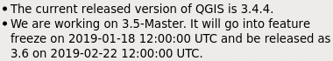
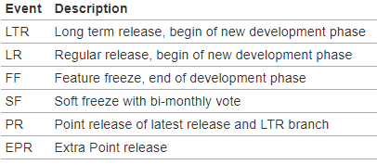
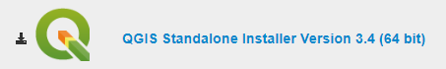
Introduction to QGIS
QGIS is a Free and user friendly Open Source Geographic Information System (GIS) licensed under the GNU General Public License. QGIS is an official project of the Open Source Geospatial Foundation (OSGeo). It runs on Linux, Unix, Mac OSX, Windows and Android and supports numerous vector, raster, and database formats and functionalities. The latest release is QGIS 3.4 [Ref]
TECHNICAL
[Ref]
QGIS is developed using the Qt toolkit and C++.
QGIS supports a number of raster , vector and mesh data formats, with new support easily added using the plugin architecture.
Read more about QGIS and the supported data formats.
Clone the GitHub Repo
In this tutorial we plan to explore the installation of QGIS 3.4.x, its basic usage and the use of QGIS as a GSKY client.
The last released older version of QGIS, probably deprecated soon, is 2.18.28.
The one integrated into NCI’s VDI is v 2.14.8. There are problems with the older versions to use them as GSKY clients.
https://download.qgis.org/
Download QGIS for your platform. Binary packages (installers)
Next: First and/or Clean Installation

Slide 5
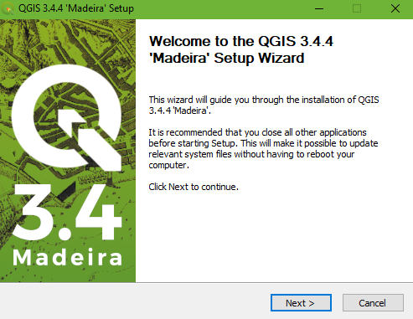
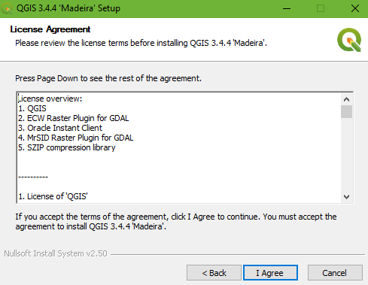
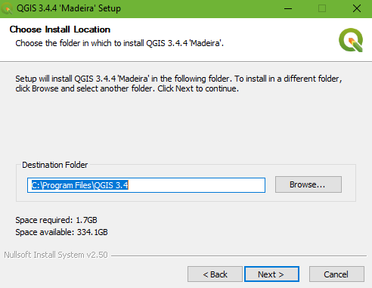
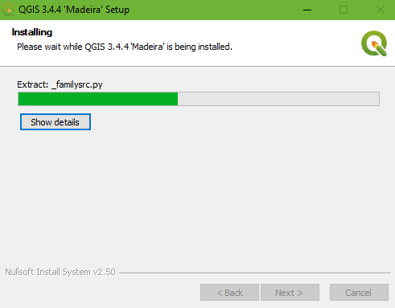
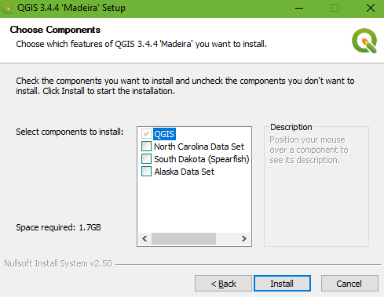
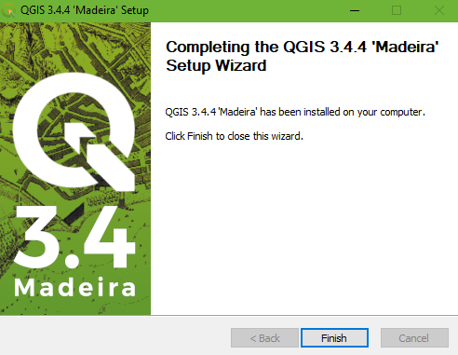
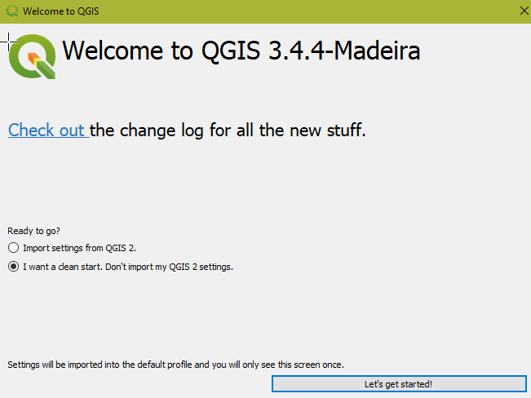
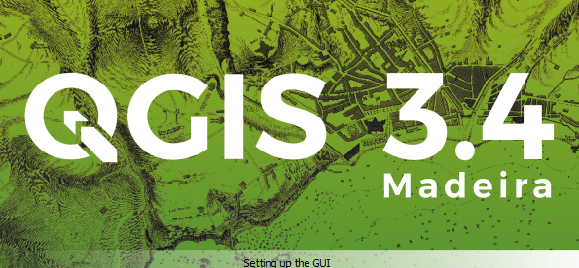
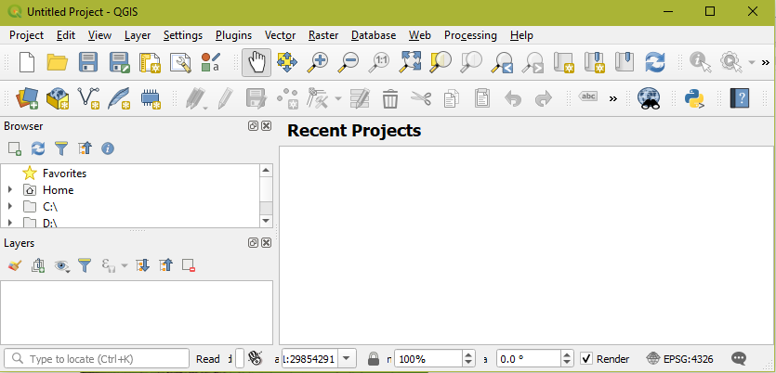

Download and Install
Download the installation package
- Double click the saved file.
2. Launch the software
TIP: For a clean start, delete the cache and previous settings, if any. This is useful if you re-install QGIS. It can be done at any time to discard previously cached images and settings for a clean start.
Next: Configure the Project Properties
Delete or rename this dir: C:\Users\userID\AppData\Roaming\QGIS

Slide 6
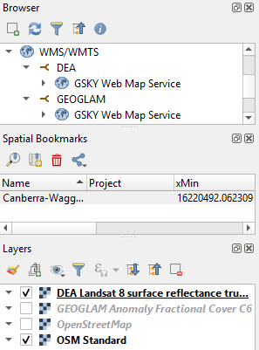
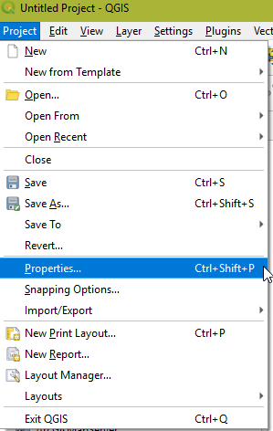
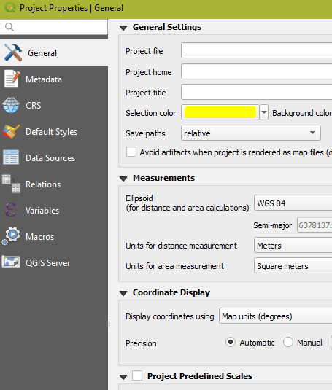
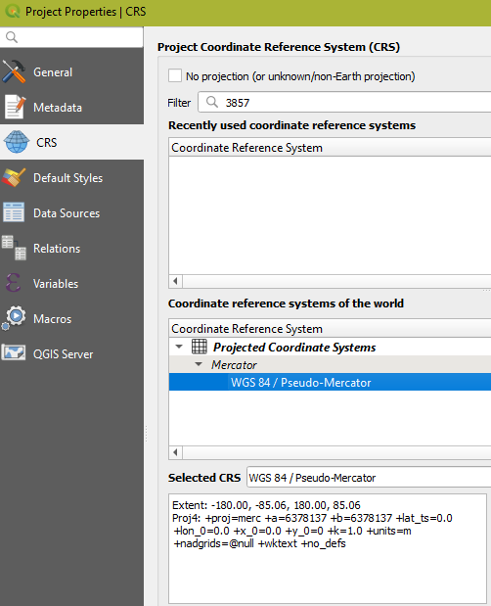
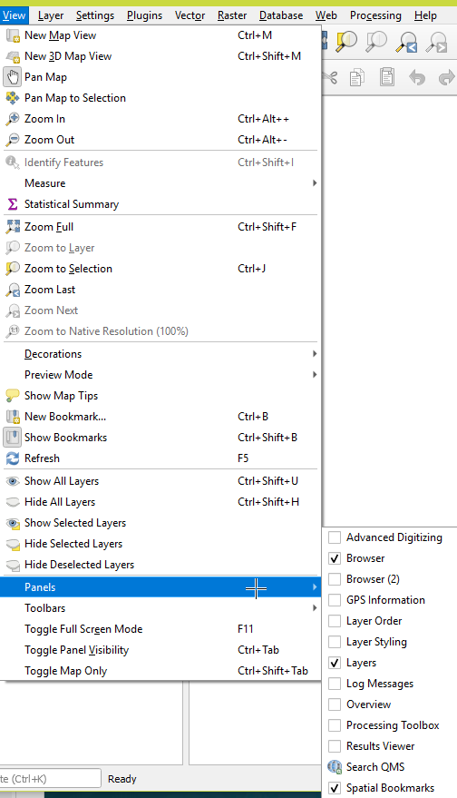
Configure Project Properties
This step is required once after a clean installation.
1. Choose Project | Properties from top menu and click CRS.
2. Type in 3857 in ‘Filter’
3. Click ‘WGS 84 / Pseudo-Mercator’ and click Apply/OK.
This step is important for GSKY layers to work properly.
4. Set the view panels
Next: Add a Base Map

Slide 7
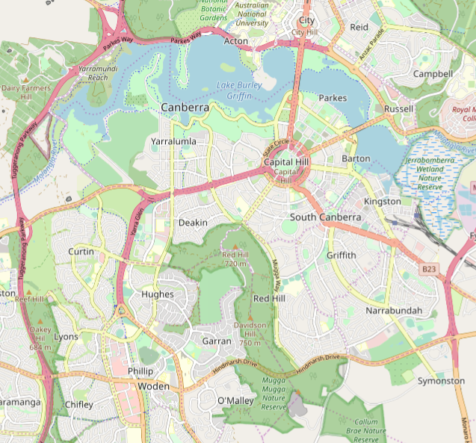
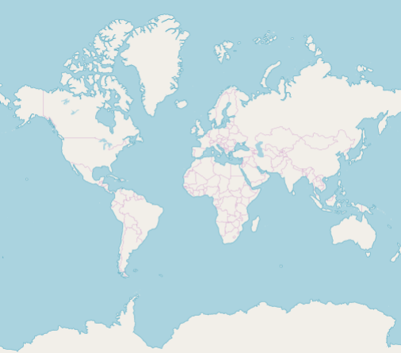
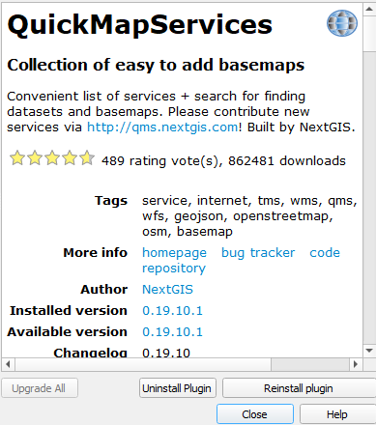
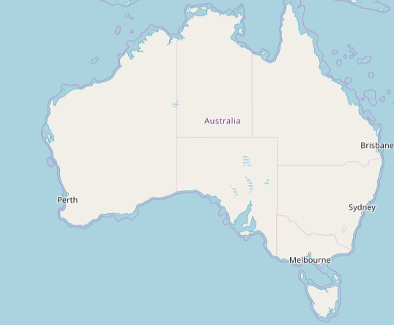
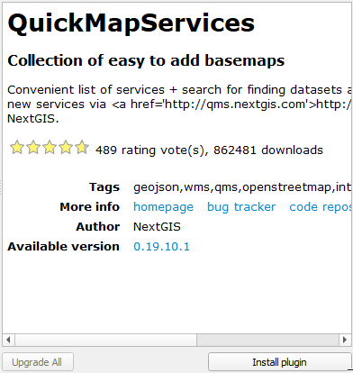
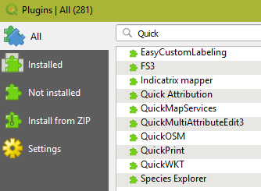
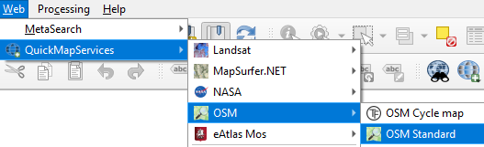
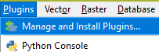
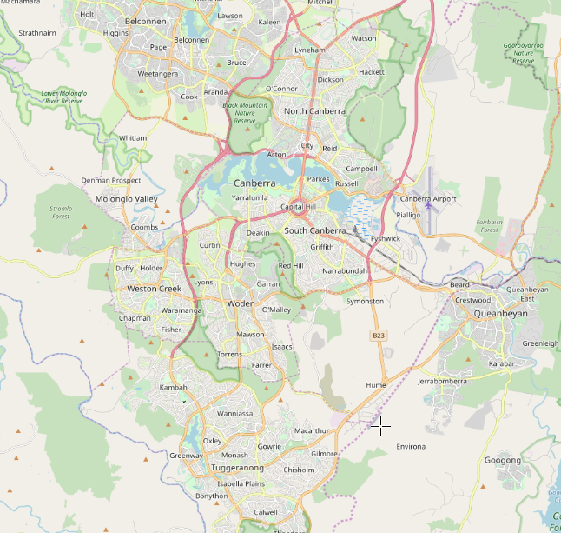
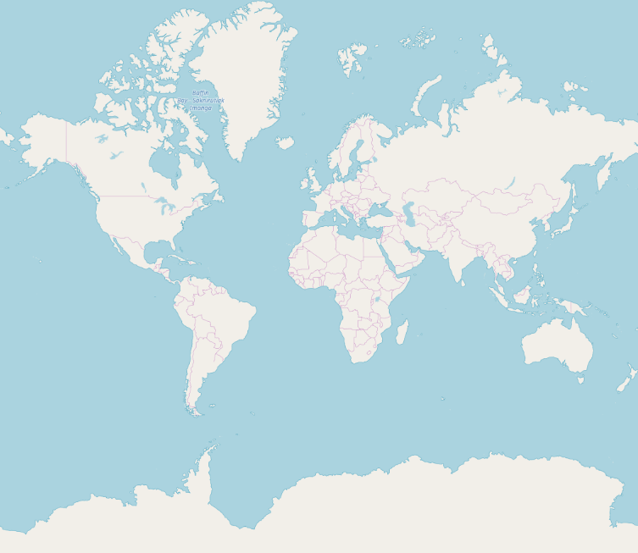
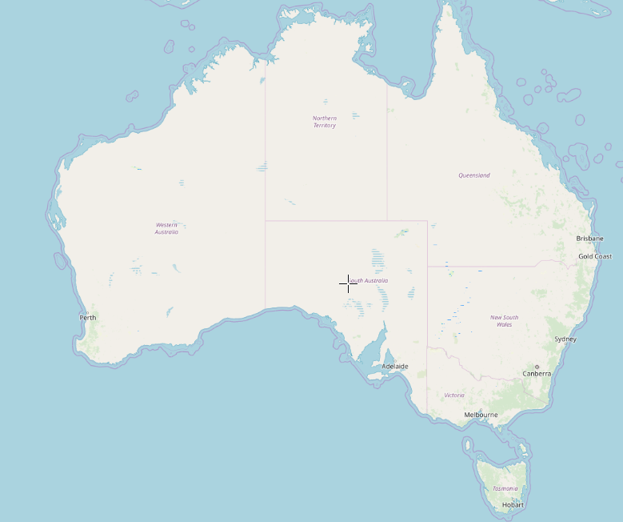
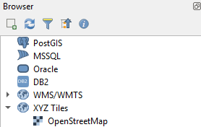
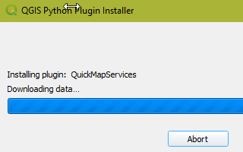
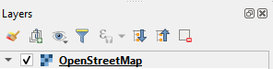
Add a Base Map
A basic street map is included by default, which is all that you require. Fancy maps can be installed as plugins. Most of them will require API Keys from their providers.
Show the OpenStreetMap Layer:
- Double click “OpenStreetMap”
Add Quick Map Services
Change a base map
Next: Add GSKY Map Services

Slide 8
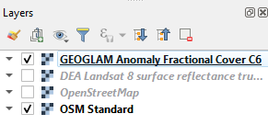
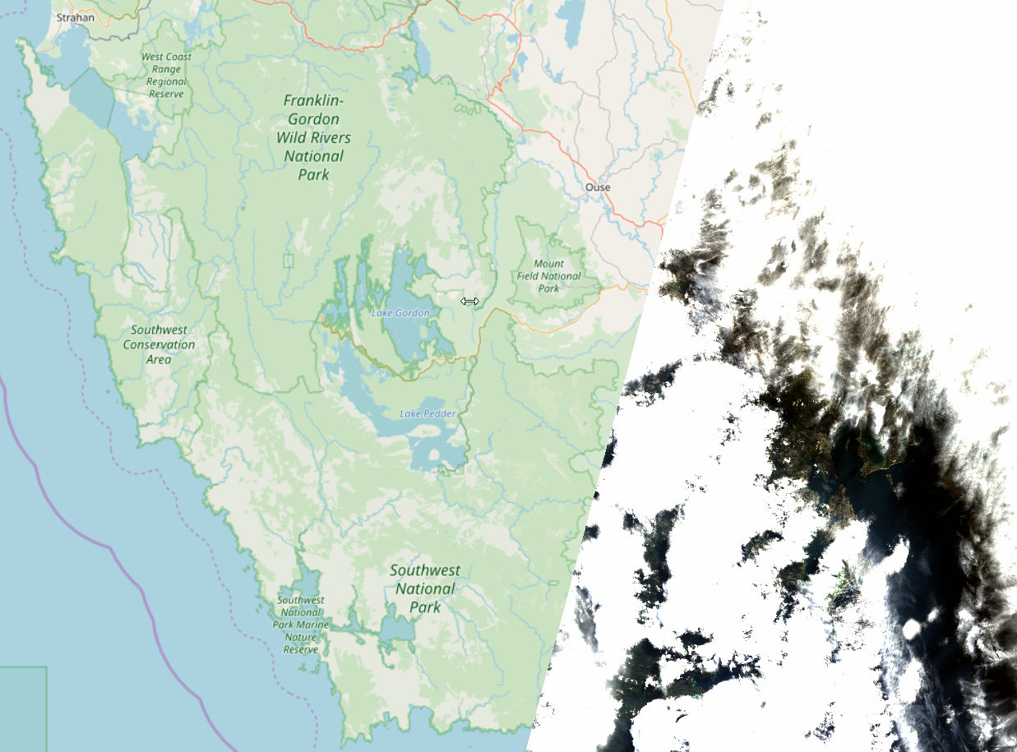
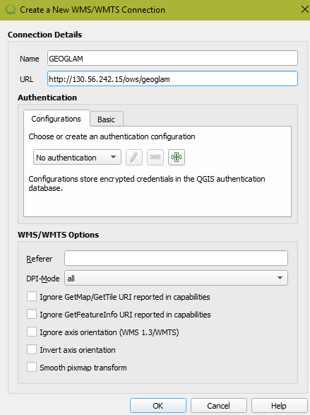
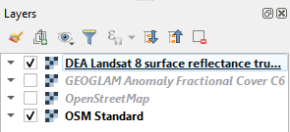
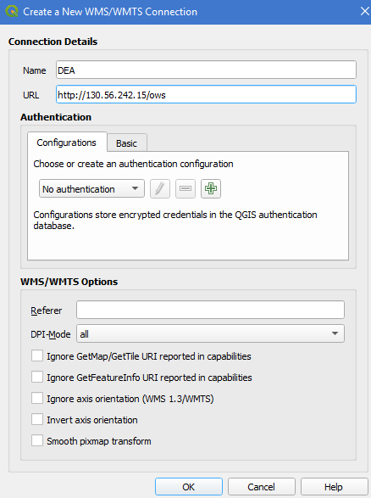
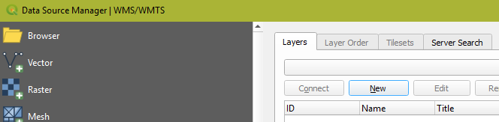
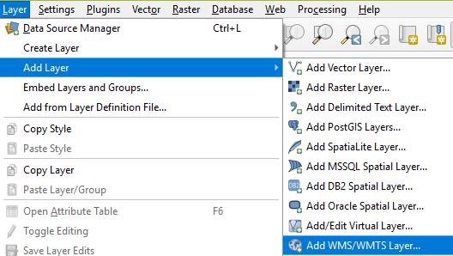
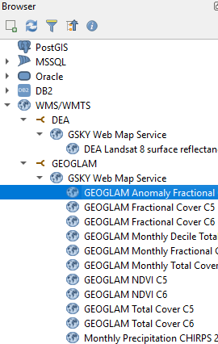
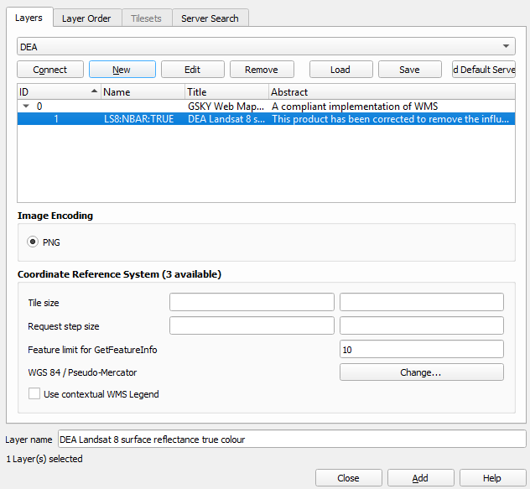
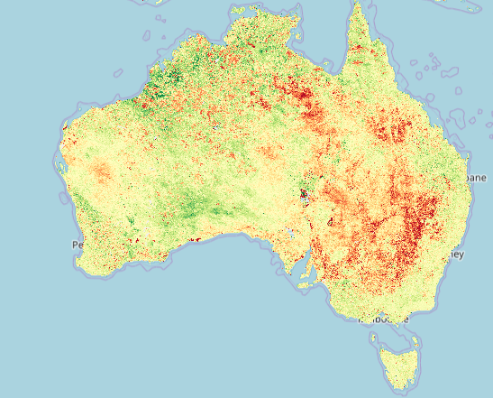
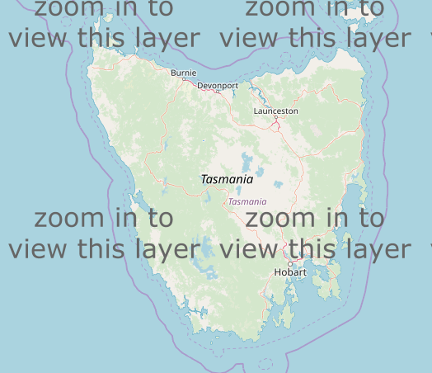
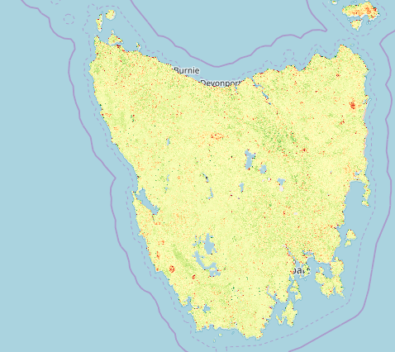
Add GSKY Map Services
In this step we will add the WMS layers to implement the GSKY service.
For demonstration, the GEOGLAM and DEA Landsat8 layers are added through the GSKY Map Service.
Add the WMS Layer(s)
Display layers(s)
Double click the layer name
Drag to top in layers’ list.
Next: Advanced Usage of QGIS
You may close without adding

Slide 9
Advanced Usage of QGIS
QGIS has several options and settings to configure the way layers are displayed. This section gives an introduction to some that are useful in GSKY services. It is by no means a comprehensive list. Some demonstrations are currently not available with the GSKY service, but may be added later.
Here we demonstrate the following:
Adding OSM Data
Adding publicly available layers in OSM
Configuring layer properties
Scale-based visibility (useful in GSKY)
Attribute Data and Labelling (not available in GSKY)
Next: Download OSM Data

Slide 10
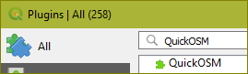
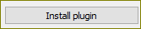
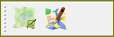
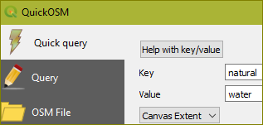
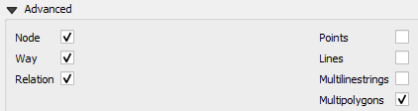
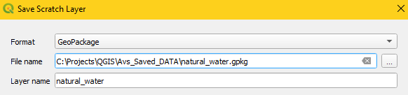
Download OSM Data
QuickOSM is a plugin that allows you to find and download data layers corresponding to a large variety of things such as water ways, roads, land use, buildings, public transport and many more. You must be zoomed into an area that has data corresponding to the layer to be added. For example, zooming to the centre of Australia and asking to add buildings layer will return empty. [Ref]
Manage and Install Plugins
STEPS
Install the QuickOSM plug-in
Plugins | Manage and Install Plugins
All | Search… | QuickOSM | Install
Add a layer
Zoom into the area (e.g. Canberra)
Vector | QuickOSM | QuickOSM…
Key = natural, Value = water
In: Canvas Extent
Advanced: Multipolygons
Run Query
Save as shape file
Click the save icon next to the layer name
Choose Format: ESRI Shapefile
Save in a directory.
Will create several files, including a *.shp
Next: Add a Water Layer
NOTE: You must download a layer for each of the zoom views (“Canvas Extent”). Thus, layers outside the area will not be retrieved. Trying to get the layer for the whole world will result in a timeout error.

Slide 11
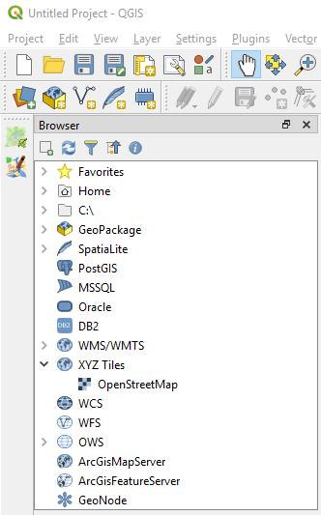












Add Layers
STEPS
Add a map layer. This must always be the last item in the Layers panel.
Browser | XYZ Tiles | OpenStreetMap
Zoom in to a small region (e.g. Canberra)
Add a water layer
Layer | Data Source Manager | Vector | File | Vector Datasets
Open a saved shape file (* See slide #n for saving a file)
Change layer color
Double click on the layer name (e.g. avs_water)
Symbology | Color or pick from displayed colors
⬅ Right-click
Next: Scale-based Visibility

Slide 12








Scale-based Visibility
Sometimes you will find that a layer is not suitable for a given scale. For example, a dataset of all the continents may have low detail, and not be very accurate at street level. When that happens, you want to be able to hide the dataset at inappropriate scales. By setting a minimum scale for visibility, a layer will be masked when the zoom level is lower.
⬅ Right-click
The water layer will disappear when the zoom level is above 100,000.
The GEOGLAM layer will only be visible at zoom levels above 4,000,000
Next: Attribute Data and Labelling

Slide 13






Attribute Data and Labelling
All the objects that are visible on the map also have attributes. Maps in a GIS aren’t just pictures. They represent not only objects in locations, but also information about those objects. ^{[Ref]} The attribute data has info like ID, name, type, etc. for each feature. e.g. Lake Burley Griffin. These can be added to the map for clarity and information.
STEPS
View the attributes
Select the layer
Click the ‘Open Attribute Table” or F6
Add Labels from the attributes
Select the layer
Click the “abc” icon in the Label Toolbar and again on the window
Choose ‘Single Lables”
Choose “abs Name” under “Label With”
Choose a color under “Stroke Color”
Edit labels
Bring up the attributes table as in (1)
Click the edit icon and type in the changes
Save
Next: GSKY via WCS

Slide 14
GSKY via WCS in QGIS
Unlike WMS service, where date selection is not possible, the WCS service lets one choose a date. The data returned will be in GeoTIFF or NetCDF format and it will be displayed by QGIS.
LIMITATIONS
While it works with GEOGLAM, the DEA end points are returning errors.
The error is caused by the absence of a ‘styles=‘ parameter in the query.
Appending it to the query, after GSKY receives it, lets it go past the error.
There are other downstream errors too that prevent the display.
QGIS sends the bounding box for the entire world (-180, -90, 180, 90) and GSKY cannot handle it.
Zooming in sends progressively smaller BBox
Most BBoxes result in either a time out or takes very long to complete.
This can be handled by setting the scale-based visibility in QGIS.
At very high zoom level the data is coming through but QGIS somehow blanks it.
Saving the output as a TIFF shows data, but QGIS gets 0 for max/min values.
func serveWCS():
if params.Styles == nil {
params.Styles = append(params.Styles, "fc")
}
if (params.BBox[0] == -180 && params.BBox[1] == -90 && params.BBox[2] == 180 && params.BBox[3] == 90) {
P("Asking for the World")
return
}
Next:

Slide 15
Differences Between Clients
Each client has variations, often subtle, in the way a call to the GSKY server is made. In most cases these result in errors.
TerriaMap
http://130.56.242.15/ows/ap?service=WMS&request=GetCapabilities&version=1.3.0&tiled=true
http://130.56.242.15/ows/ap?service=WCS&request=GetCoverage&version=1.0.0&format=GeoTIFF&crs=EPSG%3A4326&width=1024&height=781&coverage=landsat8_nbar_16day&bbox=124.56550665828182%2C-25.581678744869983%2C126.49964803478255%2C-24.105829244431018&time=2013-07-25T00%3A00%3A00.000Z&styles=fc
QGIS
http://130.56.242.15/ows/ap?SERVICE=WMS&REQUEST=GetCapabilities
http://130.56.242.15/ows/ap?SERVICE=WCS&REQUEST=GetCapabilities&VERSION=1.0.0
http://130.56.242.15/ows/ap?SERVICE=WCS&REQUEST=DescribeCoverage&VERSION=1.0.0&COVERAGE=landsat8_nbar_16day
ArcGIS
http://130.56.242.15/ows/ap?SERVICE=WMS&VERSION=1.3.0&REQUEST=GetCapabilities
http://130.56.242.15/ows/ap?SERVICE=WMS&VERSION=1.3.0&REQUEST=GetMap&CRS=CRS:84&BBOX=141.145004732797929136723,-34.3879192167578153771501,142.218760289416650266503,-33.5507815259593158430107&WIDTH=512&HEIGHT=400&LAYERS=landsat8_nbar_16day&STYLES=&EXCEPTIONS=XML&FORMAT=image/png&BGCOLOR=0xFEFFFF&TRANSPARENT=TRUE&
http://130.56.242.15/ows/ap?SERVICE=WCS&REQUEST=GetCapabilities
http://130.56.242.15/ows/ap?SERVICE=WCS&VERSION=1.0.0&REQUEST=DescribeCoverage&coverage=sentinel2_nbart_daily,LS8:NBAR:TRUE,landsat8_nbar_16day,landsat8_nbar_16day_Tiff,wofs
Next:

Slide 16
Title
Next:

Slide 17






Acknowledgements

